Slide 1
Family / personal budget management
Partner: University of Malaga

Slide 2
Objectives & Goals
At the end of this module you will be able to:
Identifying and differentiating between expenditures and payments.
Identifying and differentiating between collections and incomes.
Managing our money in the best possible way.

Slide 3
Index
1.- What is a family budget?
2.- What are the main economic movements in a household economy?
3.- How to prepare a budget?
4.- What are the different scenarios for a family budget?
5.- Basic guidelines to follow for a good personal budget.

Slide 4
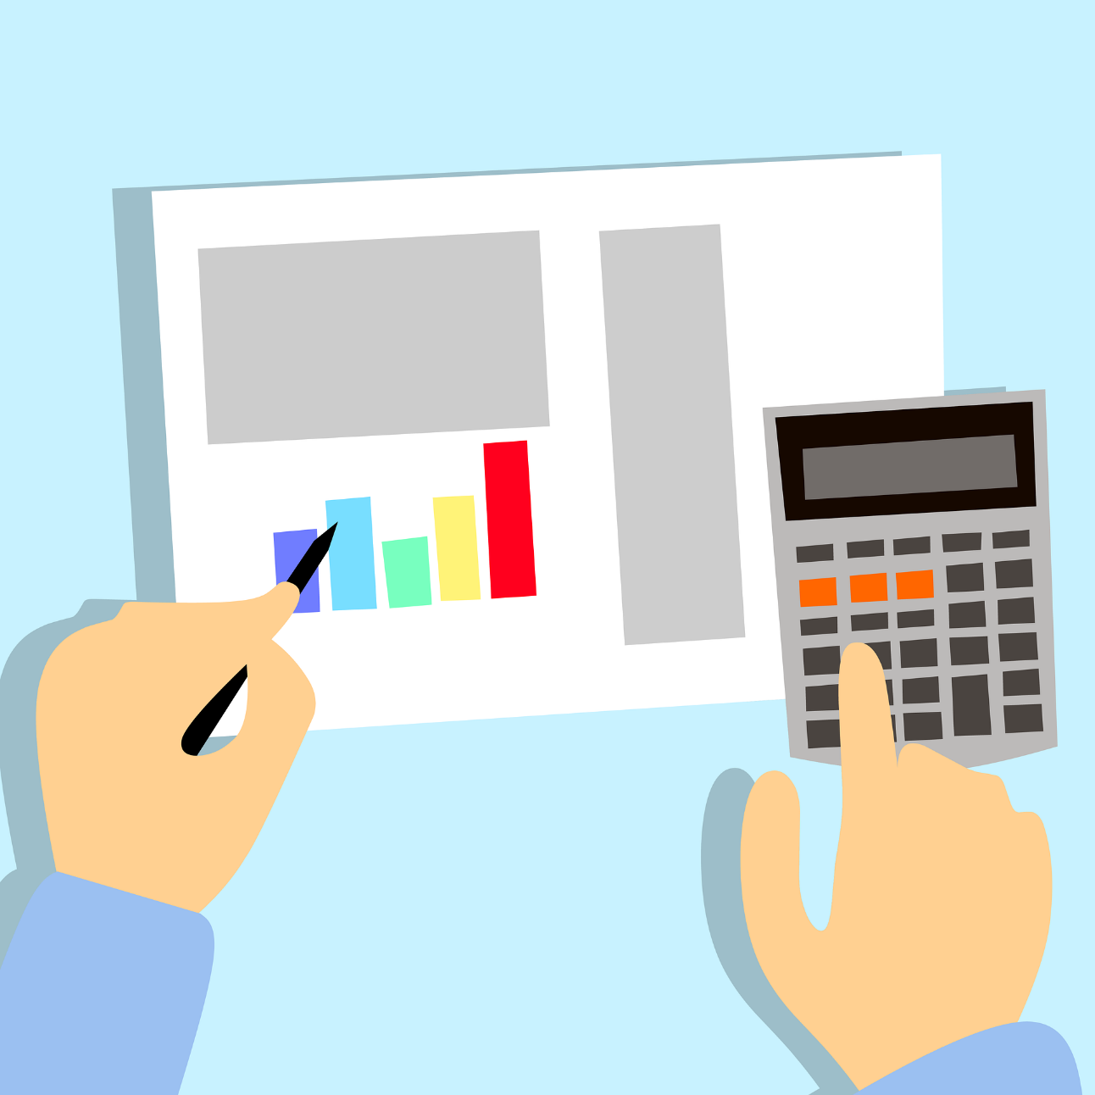
1. What is a family budget?
A family budget is a document that summarises in figures, in an organised way, the income and expenditure of a family over a certain period of time.
With a well-done budget, the family has a global vision, with valuable information about their real consumption habits, and can analyse them and make decisions regarding the destination of each of the incomes at their disposal and thus better plan their financial future.

Slide 5
2. What are the main economic movements in a household economy?
Some of the possible household incomes are: wages, rental income, interest on bank deposits, dividends on shares, social benefits, pensions, allowances... In short, household income represents the money available to a family to spend on goods and services or to use for savings or investment.
With regard to expenses, we can differentiate them according to their nature:
Mandatory fixed expenses: These are the ones that we cannot stop paying or change the amount. Moreover, we know them in advance. They will always be there month after month, for example the mortgage, the rent, the community fees or the bank loans.

Slide 6
2. What are the main economic movements in a household economy?
Necessary variable expenses: They are not mandatory, but they are necessary for our daily lives. We can reduce them, but not eliminate them. Such as food, transport, clothing, electricity bills, etc. They can be reduced if we consume more moderately and use some tricks: use energy-saving light bulbs, lower the heating temperature by a few degrees, compare prices in shops...
Occasional or discretionary expenditure: These are irregular expenses, of an extraordinary or sporadic nature. For example, a traffic fine. Some are unavoidable, such as medical expenses, but others can be reduced or even eliminated if necessary. This is the case for leisure expenses, travel, etc.

Slide 7
2. What are the main economic movements in a household economy?
Is an income the same as a collection? Not exactly:
An income arises when we have generated the right to receive a sum of money. For example, our work generates an income that we will receive at the end of the month. Or when a shop sells on credit and issues an invoice to its customer. In both cases a collection right is generated.
The collection is when we actually receive that amount. In our example, we are paid when our company pays our salary through a bank account or in cash. Or when the customer pays the invoice issued by the business.
When the income and collections coincide on the same date, we would be dealing with cash income.

Slide 8
2. What are the main economic movements in a household economy?
Is an expense the same as a payment? No:
An expenditure is incurred when an obligation to pay a sum of money has been entered into.
Payment is when the money is delivered physically or through a debit to a bank account.
For example, if a person decides to buy a household appliance, that person should note the expenditure in his/her budget on the same day he/she makes the purchase. However, it may happen that the payment for the appliance is made in instalments, so that the expenditure and the payments do not coincide at the same time.

Slide 9
3. How to prepare a budget?
There are some basic steps to any budget:
Identify income and expenditure items. It is essential to know what income we have for the year and what expenses we have to meet.
Income: We start by listing all the sources of income. The most important are usually the salary or pension in the case of retirees, but do not forget other possible income such as alimony, interest from bank accounts, subsidies, extra work and payments from social security schemes.

Slide 10
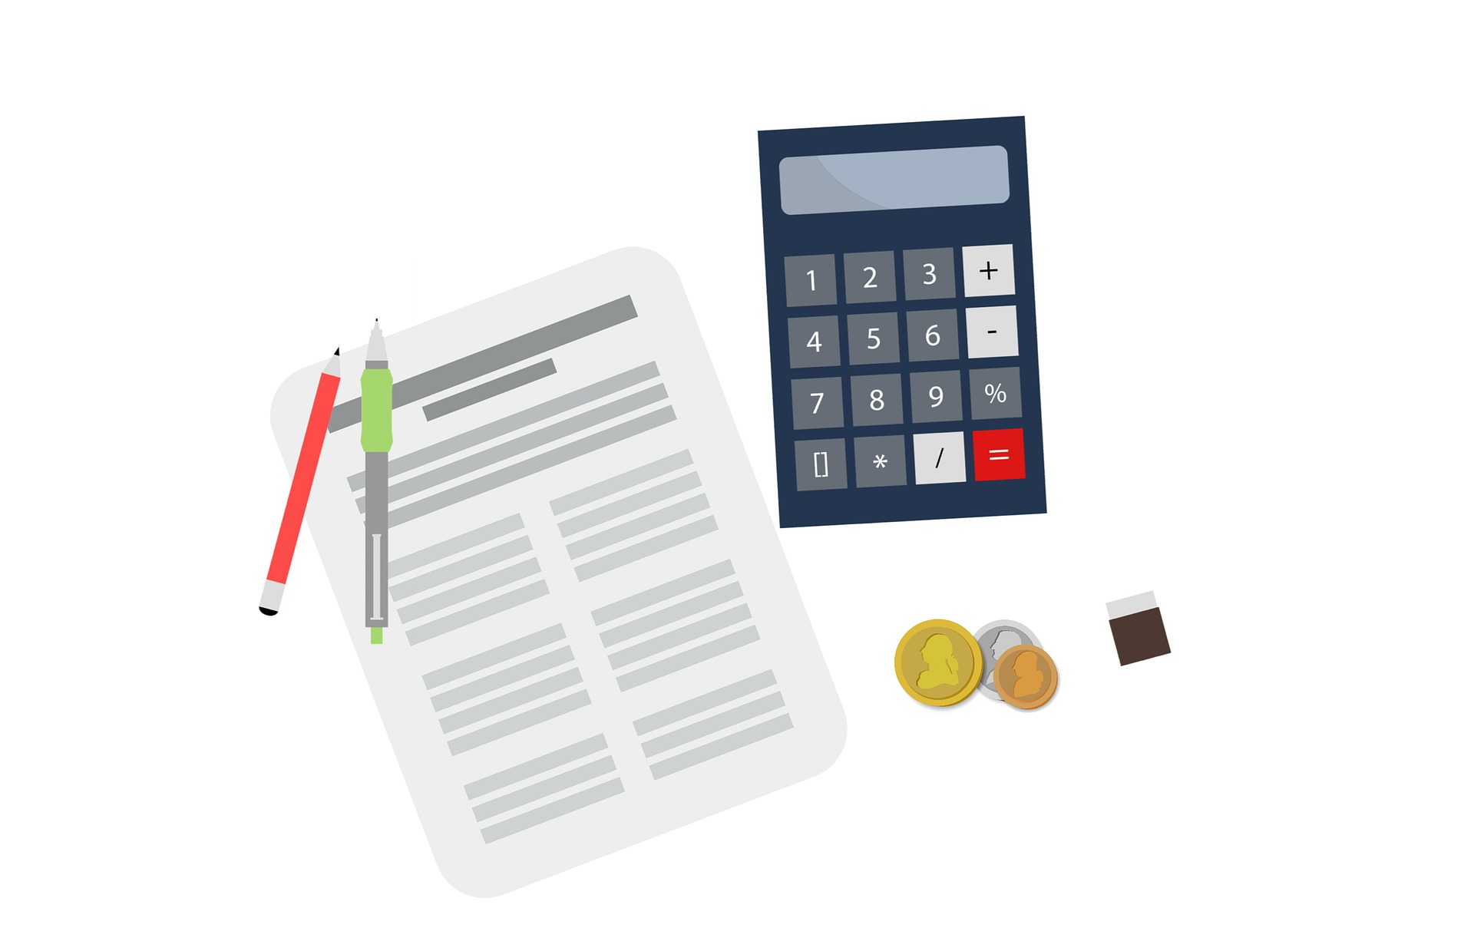
3. How to prepare a budget?
Expenses: Expenses are all outflows of money. To really know where you stand, you need to include all your current expenses, from housing to small daily outlays, or approximations of them. And you should not forget other occasional expenses such as holidays, birthday presents and Christmas shopping, or unforeseen expenses that may arise.
All expenses, however small, should be identified and noted down and, if possible, differentiated according to their nature, so that it will be easier to control them and, if necessary, to study which of them should be eliminated.

Slide 11
3. How to prepare a budget?
Quantify these items accurately, taking into account whether they are subject to revision, taxation or any extra expenses. You may need to make adjustments as the amounts budgeted for certain expenses may not be realistic.
Determine the dates of collections and payments. This avoids surprises due to unforeseen delays.
This information should be transferred to a template or spreadsheet with monthly divisions in order to monitor collections and payments.

Slide 12
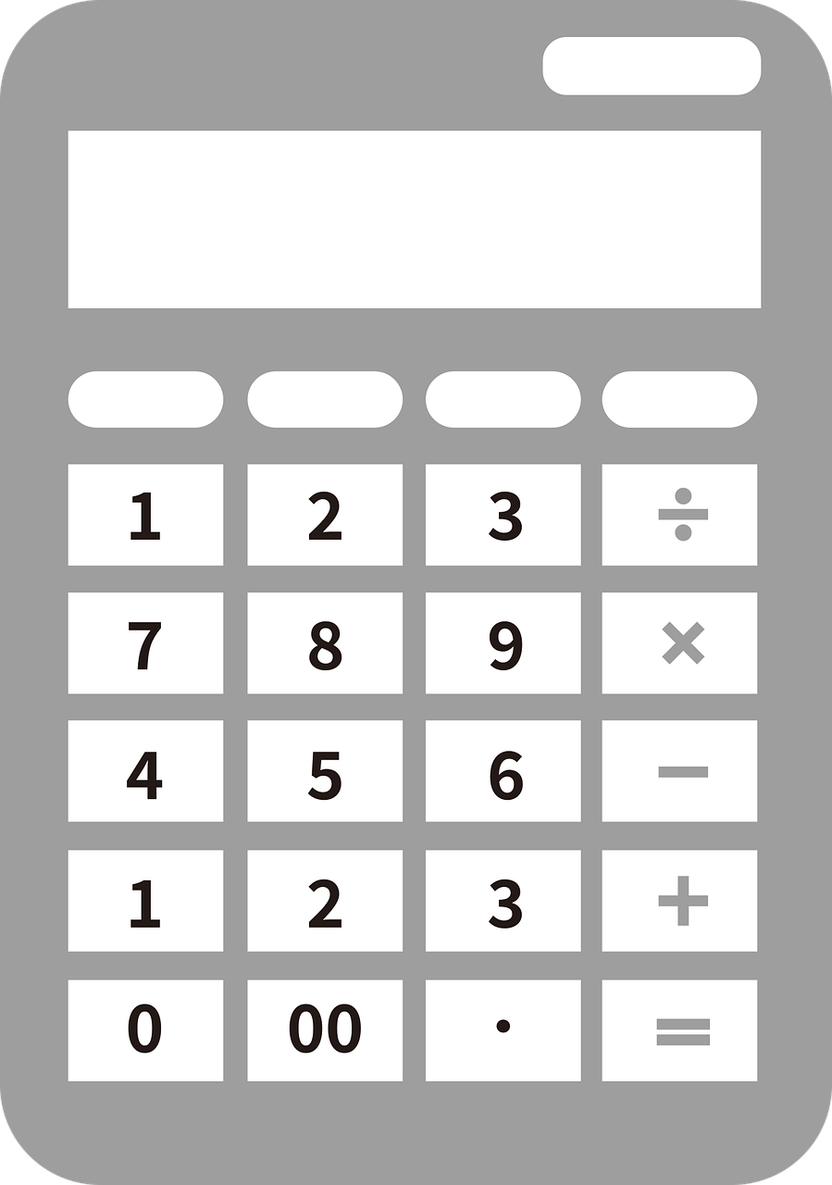
3. How to prepare a budget?
It is normal to revise the budget several times to bring it in line with reality with achievable objectives. There are two approaches to managing it.
Knowing the resources available throughout the year, expenditures can be adjusted to those incomes (budget constraint).
Another approach is to identify expenditures that are unavoidable, for which there is no choice but to adjust income, either by seeking new sources of income from the market or by borrowing.

Slide 13
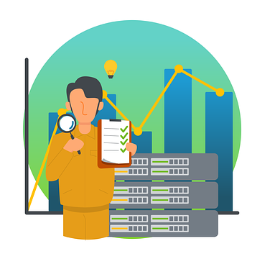
4. What are the different scenarios for a family budget?
The balance of a year's budget depends on the balance between inflows and outflows in the household economy:
If the inflows match the outflows, we will have a full equilibrium.
If inflows exceed outflows, there will be an available balance with which to acquire new assets or increase the balance of existing assets, or to reduce unpaid liabilities.

Slide 14
4. What are the different scenarios for a family budget?
If inflows are lower than outflows, an imbalance is created that has to be covered in some way:
By making use of heritage funds, which results in a decrease of wealth.
By means of a credit operation, which implies an increase in family indebtedness. The capital obtained has to be repaid within a fixed period of time and interest has to be paid back. An increase in indebtedness means that a commitment is made to face a financial burden, which will have an impact on the budget for the following year(s).
We can eliminate unnecessary expenses.

Slide 15
4. What are the different scenarios for a family budget?
A budget must be sustainable, which means that the regular income for the year is sufficient to cover regular expenditure and the repayment of loan instalments previously contracted.
In addition, it may be appropriate to build up some reserves to cope with exceptional situations or needs.

Slide 16
5. Basic guidelines to follow for a good personal budget.
Some guidelines can be taken into account to better manage the family budget:
The budget should be as realistic as possible and cover all expenditure and income.
Daily expenditure tracking will show how we spend our money.

Slide 17
5. Basic guidelines to follow for a good personal budget.
Establish a list of basic needs and another list of goods and services that we usually purchase each month, in order to check whether some of our recurrent expenses are really necessary.
If we are struggling to make ends meet. On the one hand, we can look for ways to increase our income or, on the other hand, we will have to reduce expenses or a combination of both.

Slide 18
5. Basic guidelines to follow for a good personal budget.
When you have to meet expenses for assets, such as a house or a car, which are to be used over an extended period of time, it is normal that they cannot be covered by the normal income of a financial year. It is therefore reasonable to borrow for this purpose, assuming that in future years the corresponding part of the debt plus interest will have to be repaid.

Slide 19
5. Basic guidelines to follow for a good personal budget.
It is reasonable that the repayment period of the loan should be in line with the period of enjoyment of the financed good or service. For example, it would make little sense to take out a five-year loan to finance the purchase of an item that needs to be replaced every year.
Include savings as part of your fixed expenses, both for a cushion and for specific goals: buying a car, travelling, your children's schooling...

Slide 20
Summing up
Family budget
Collection and payment
The collection is when we actually receive the amount of income. Payment is when the money of an expense is delivered.
A family budget is a document that summarises in figures, in an organised way, the income and expenditure of a family over a certain period of time.
Financial sustainability
Economic movements
A budget must be sustainable: regular income for the year is sufficient to cover regular expenditure and the repayment of loan instalments.
Incomes (wages, pensions, allowances...) and expenses (mandatory fixed, necessary variable, occasional).

Slide 21
Thank you!
Partner: University of Malaga

