Slide 1
Ethical finance for a just society
Partner: Soc. Coop. Fuori dal Sommerso

Slide 2
Objectives & Goals
At the end of this module you will be able to:
Be more aware of the impact that your money may have on the society and the environment
Be stimulated to direct your savings towards responsible and sustainable banks and investment products
Know which parameters and documents to look for to verify the sustainability of a financial product
Recognize greenwashing practices

Slide 3
Index
Unit 1
The management of saving and its impact on society and environment
Unit 2
Sustainable finance and ESG metrics
Unit 3
Is sustainable finance also ethical?
Unit 4
Ethical and sustainable investment tools

Slide 4
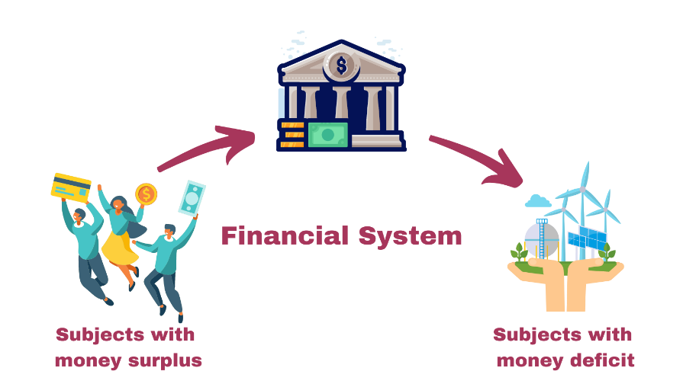
1. The management of savings and its impact on society and environment
Banks and other financial intermediaries transfer money from subjects who have accumulated savings (like households) to subjects in financial deficit, who need to invest or spend more than their available resources (like companies or public administrations).

Slide 5
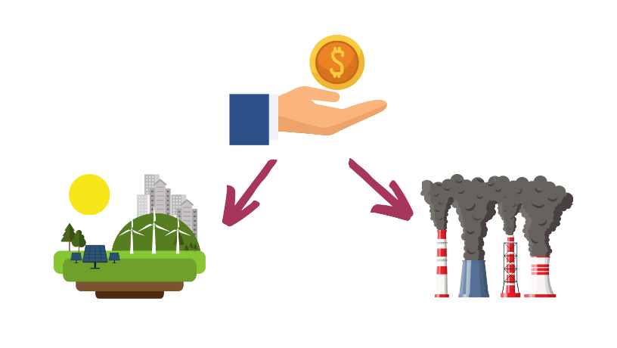
1. The management of savings and its impact on society and environment
When deciding how to invest money, savers and banks have a crucial role in directing capitals towards subjects and activities that generate a positive impact on the society and on the environment.
Thus we can say that the management of the savings has concrete consequences on the reality that surrounds us which could be both positive and negative depending on the type of investment we make.

Slide 6
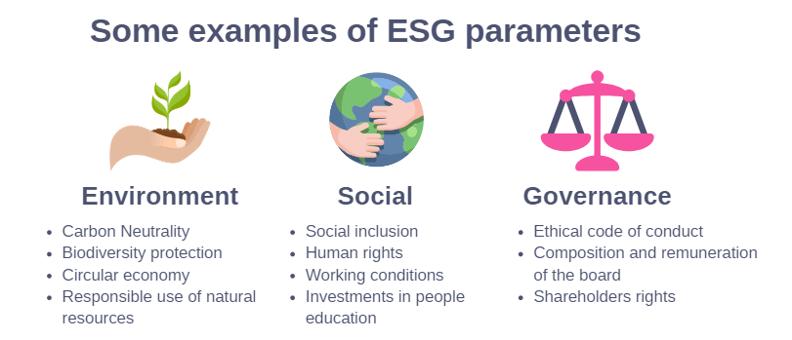
2. Sustainable Finance and the ESG metrics
«Sustainable finance» refers to finance that takes environmental factors into account in investment decision-making, directing capital towards longer-term sustainable activities and projects. Finance is defined as sustainable based on the ESG parameters, i.e. according to environmental (Environment), social (social) and corporate governance (Governance) factors.

Slide 7
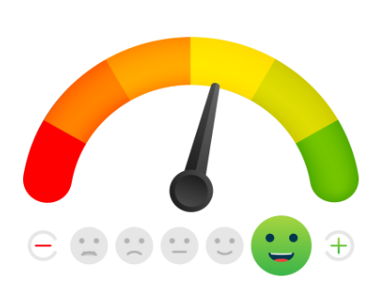
2. Sustainable Finance and the ESG metrics
ESGs are assessed with scores by specialized agencies (ESG ratings) that express a summary evaluation on the level of environmental, social and corporate governance sustainability of issuers (companies, states, supranational organizations), securities and/or collective investment instruments.

Slide 8
2. Sustainable Finance and the ESG metrics
For "financial products targeting sustainable investments", traders must disclose how they achieve sustainable investment objectives. This information must be made available on the website, in the pre-contractual information and in the periodic reporting, as set out by the SFDR (Sustainable Finance Disclosure Regulation) of the EU.
The complexity and lack of transparency of the methodologies used to calculate ESG scores and the different weights attributed to ESG factors by different agencies limit the reliability and comparability of ESG scores, leaving the door open to greenwashing practices.

Slide 9
2. Sustainable Finance and the ESG metrics
Greenwashing is a communication or marketing strategy of companies, institutions or organizations that present as eco-sustainable activities and products that in fact are not. With greenwashing, companies deceptively try to increase their sales by exploiting the growing sensitivity of consumers on environmental sustainability.
In the most frequent cases of greenwashing, the communication has the following characteristics:
there is no accurate information or data to support the statement;
the information and data are declared as certified while they are not recognized by authoritative bodies;
single characteristics of what is communicated are emphasized;
the information is so general as to create confusion among consumers;
false or counterfeit labels may be used;
Untrue environmental claims are reported.

Slide 10
2. Sustainable Finance and the ESG metrics
Key takeaway
So if you decide to buy a product or make an investment because of the sustainability characteristics that are claimed, you should also carefully inform ourselves through sources other than those who propose the product!
BE AWARE OF GREENWASHING!

Slide 11
3. Is sustainable finance also ethical?
Sustainable finance….
… or ethical finance
In sustainable finance, the maximization of profit and the value of shares and dividends remain predominant, trying not to harm the environment too much.
The approach of ethical finance is antithetical: the realization of economic profits is pursued, but it is functional to the objective of maximizing the benefits for people, communities and the planet

Slide 12
3. Is sustainable finance also ethical?
The risks of a fragmentary approach are mainly borne by the bank's customers, the environment and society. In fact, customers risk being misled thinking of making fully green and fair investments, the environment derives a limited benefit from the investment and society sees its rights to health and a just future threatened.
Despite this, the fragmented approach of sustainable finance persists because it benefits economic operators.

Slide 13
3. Is sustainable finance also ethical?
In the EU Regulation 2019/2088, sustainability is defined almost exclusively by looking at the environmental component, in particular the reduction of CO2 emissions. For ethical finance, on the other hand, entire economic sectors must necessarily be excluded from investments (weapons, fossil fuels, tobacco, pornography, etc.). In the approach of ethical finance, the environmental, social and governance aspects have the same importance.
Key Takeaway
Therefore we can say that ethical finance is certainly also sustainable, but the so called “sustainable finance”, may not be ethical.

Slide 14
4. Ethical and sustainable investment tools
Sustainable and Responsible Investment Funds (SRI): they are investment funds that combine the search for performance with socially responsible issues. It is a type of financial instrument that operates through the raising of capital from multiple savers and invests in different assets such as shares, bonds, raw materials and other financial instruments. When selecting investments, these funds meet the ESG (Environmental, Social and Governance) criteria. The environment, social and human rights and transparency of governance characterize the investment choices of the fund.

Slide 15
4. Ethical and sustainable investment tools
Social Lending: these are personal loans provided by individuals to other individuals or businesses through specific internet platforms and therefore without going through traditional channels such as banks or other financial companies. It literally means "social loan" and, as the term suggests, translates into a form of financing / investment carried out through specialized and authorized web portals, which bring together supply and demand. In practice, it connects those who need to apply for a loan or financing for a project with high yield potential and those who have a certain liquidity to invest. In this way, even a small saver has the opportunity to ensure a return in a direct, autonomous and even innovative way.

Slide 16
4. Ethical and sustainable investment tools
What are the advantages of social lending?
For lenders, the main advantage is ease of use and good expected returns, because the selected projects, have already been classified by the platforms themselves, which have received a sort of sticker, or a rating.
For those who receive the loan / financing the advantage is the speed of management. Since these operations are concluded digitally, everything happens quickly, with standard and transparent steps. Not only that: generally you also get lower interest rates than banks.
What are the risks of social lending?
The risks are those of any investment: it is not said that the expected returns are centered, but a careful choice of the amount to be invested and the project to be financed, minimizes this risk, as indeed also happens through traditional channels.

Slide 17
Summing up
Sustainable Finance
Greenwashing
Finance that takes environmental factors into account when making investments
A communication or marketing strategy of companies, institutions or organizations that present as eco-sustainable activities and products that in fact are not..
Ethical Finance
ESG
Finance that considers both environmental, social and governance factors when making investments.
The most relevant parameters that are used to assess the sustainability of a company or of an investment product.

Slide 18
Thank you!
Partner: Soc. Coop. Fuori dal Sommerso

